Slide 1
Demand for Higher Education Programs
August 27th, 2026

Slide 2

Agenda
What Is a Program Evaluation System?
Student Demand Indicators
Employment: Current Indicators
Program of the Month
Summary

Slide 3
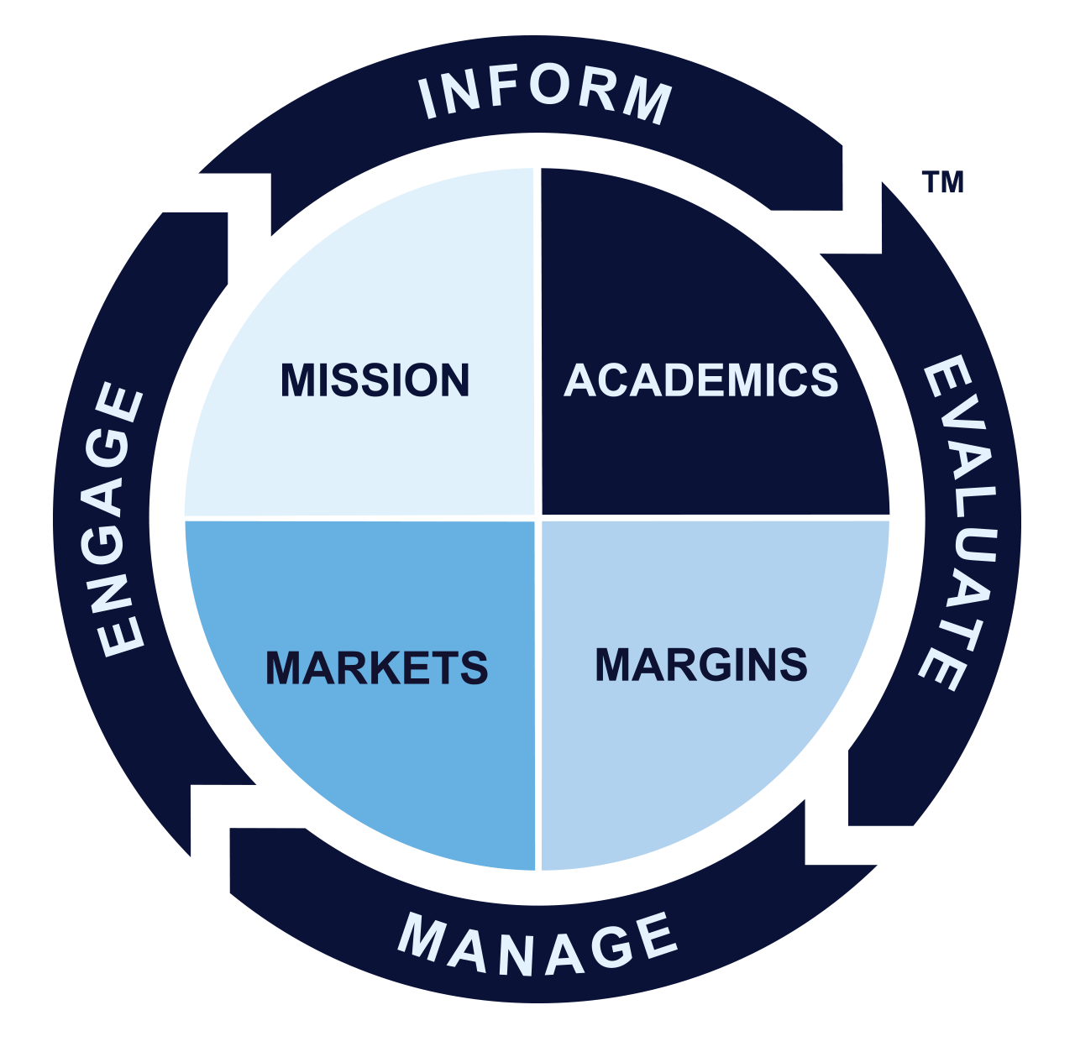
Program Evaluation System Overview

Slide 4
Agenda
What Is a Program Evaluation System?
Student Demand Indicators: Google Keywords
Employment: Current Indicators
Program of the Month
Summary

Slide 5

Google Search Trends: Programs
Gray DI tracks searches for over 900 programs, which represent 90% of all US completions.
Source: Gray DI’s PES Keyword Search Dashboard

Slide 6
Google Search Trends: Programs
Since January, monthly year-over-year growth has been, on average, –31%.
-36% YoY
Source: Gray DI’s PES Keyword Search Dashboard
Notes:
This could be due to AEO

Slide 7
Fastest–Growing US Search Volumes (Associate and Certificate Levels)
Drafting and Design Tech continues to dominate program keyword searches.
Fastest-Growing Google Searches*
Associate and Certificates
July Year over Year
*Minimum searches July 2025: 10,000
Excludes CIP codes ending in 99, “Other”
Source: Gray DI’s PES Keyword Search Dashboard

Slide 8
Fastest–Growing US Search Volumes (Bachelor’s and Above Levels)
Computer Programming grew 136% year over year.
Fastest-Growing Google Searches*
Bachelor’s and Above
July Year over Year
4 | Arts and Humanities
3 | Health-Related
3 | Other
*Minimum searches July 2025: 10,000
Excludes CIP codes ending in 99, “Other”
Source: Gray DI’s PES Keyword Search Dashboard

Slide 9
Agenda
What Is a Program Evaluation System?
Student Demand Indicators: Spring New Enrollment
Employment: Current Indicators
Program of the Month
Summary

Slide 10
Spring New Student Enrollment: Certificate and Associate Programs
In Spring 2026, new enrollment was flat year over year.
+8%
+2%
0
+7%
-4%
Source: Gray DI’s PES Program Enrollment Dashboard

Slide 11
Associate and Below Spring New Enrollment Year-over-Year Change
In Spring 2026, Building/Construction Site Mgmt grew 36% year over year.
4 | Health and Support
4 | Technician
2 | Other
Source: Gray DI’s PES Program Enrollment Dashboard
Minimum 1,000 newly enrolled prior year.

Slide 12
Spring New Enrollment: Bachelor’s Programs
In Spring 2026, bachelor’s new enrollment fell 4% year over year.
+6%
+2%
-4%
-8%
-2%
Source: Gray DI’s PES Program Enrollment Dashboard

Slide 13
Bachelor’s Spring New Enrollment Year-over-Year Change
In Spring 2026, Supply Chain grew 19%.
Source: Gray DI’s PES Program Enrollment Dashboard
*Minimum 1,000 enrolled prior year.

Slide 14
Spring New Enrollment: Graduate Programs
In Spring 2026, graduate new enrollment fell 3% year over year.
+5%
+3%
-3%
-8%
0
Source: Gray DI’s PES Program Enrollment Dashboard

Slide 15
Master’s and Doctoral Spring New Enrollment Year-over-Year Change
In Spring 2026, Artificial Intelligence grew 51% year over year.
8 | Health-Related
2 | Other
Source: Gray DI’s PES Program Enrollment Dashboard
*Minimum 1,000 enrolled prior year.

Slide 16
Agenda
What Is a Program Evaluation System?
Student Demand Indicators: International Demand
Employment: Current Indicators
Program of the Month
Summary

Slide 17
International Student Demand
In July 2026, international student interest in US programs fell 10% year over year.*
The highest page views came from India.
-10% YoY
Source: Gray DI’s PES International Student Demand Dashboard

Slide 18
International Page Views: July’s Fastest-Growing Programs Year over Year.*
Three programs grew, one was flat, and six fell year over year.
*Minimum page views prior year: 2,000
Source: Gray DI’s PES International Student Demand Dashboard

Slide 19
Agenda
What Is a Program Evaluation System?
Student Demand Indicators: Coursera
Employment: Current Indicators
Program of the Month
Summary

Slide 20
Coursera: July 2026 New Course Enrollment
In July, the fastest-growing courses were in tech, data, and business
4
Tech
5
Data
1
Business
Source: Gray DI’s PES Non-Degree Dashboard, Coursera
*Minimum 10,000 enrolled prior year

Slide 21
1701845 | 3589188
Coursera: July’s Fastest-Growing Skills
In July, AI Personalization skills grew 887% year over year.
6 | AI
4 | Business
Source: Gray DI’s PES Non-Degree Dashboard, Coursera
*Minimum 50,000 skills prior year.

Slide 22
Agenda
What Is a Program Evaluation System?
Student Demand Indicators
Employment: Current Indicators
Program of the Month
Summary

Slide 23
US Job Postings Trends
In July, job postings fell 3% year over year.
Source: Gray DI’s PES Workforce Insights Dashboard

Slide 24
July 2026 Fastest-Growing Job Postings Year over Year
In July, Industrial Engineers grew 60% year over year.
2 | Health
4 | Business
2 | Tech and Engineering
2
Trades
*Minimum 10,000 postings volume
Excludes unskilled labor
Source: Gray DI’s PES Workforce Insights Dashboard

Slide 25
Which skills are growing in demand in the US?
In July, demand for skills in operations had the greatest year-over-year growth.
3 | Business/Operations
2 | Software & Tech
3 | Manufacturing
2
Compliance
Source: Gray DI’s PES Workforce Insights Dashboard
* Minimum 20,000 Skills

Slide 26
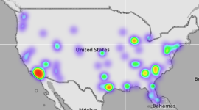
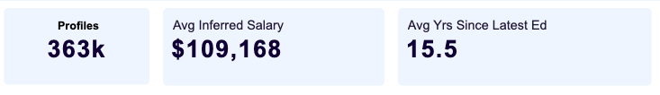
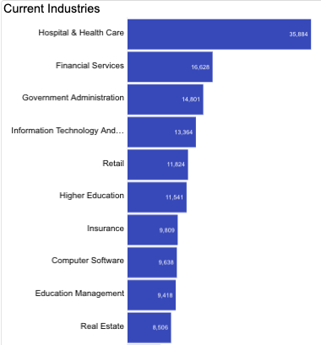
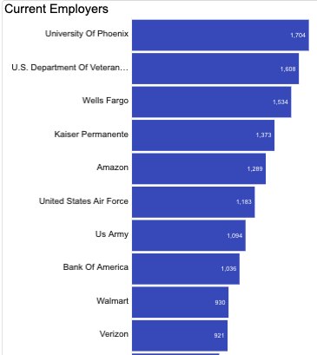
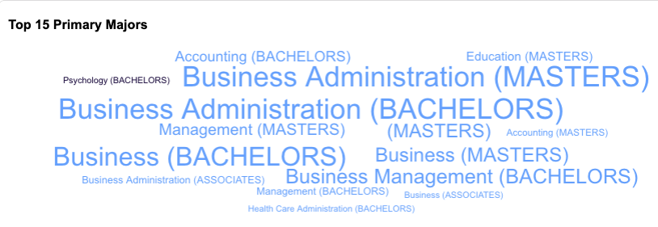
Alumni Matching
Employment metrics about your graduates
Source: Gray DI’s Alumni Outcomes

Slide 27
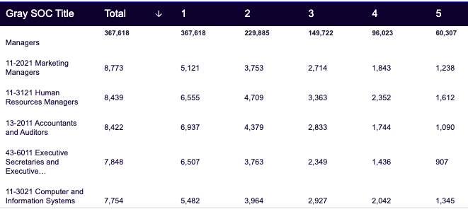
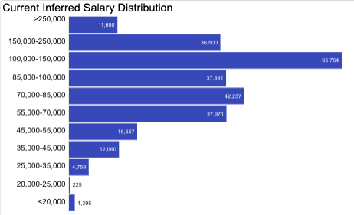
See data by job order and wages.
Source: Gray DI’s Alumni Outcomes

Slide 28
Agenda
What Is a Program Evaluation System?
Student Demand Indicators
Employment: Current Indicators
Program of the Month
Summary

Slide 29
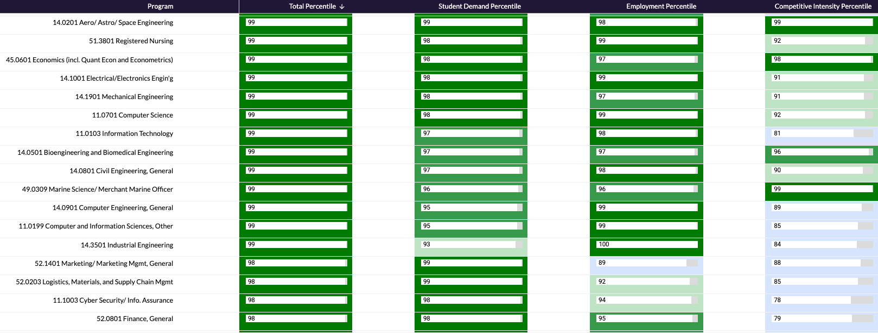
Percentile rank your programs for student demand, employment, and competition.
Let’s look at a Bachelor’s in Cybersecurity.

Slide 30
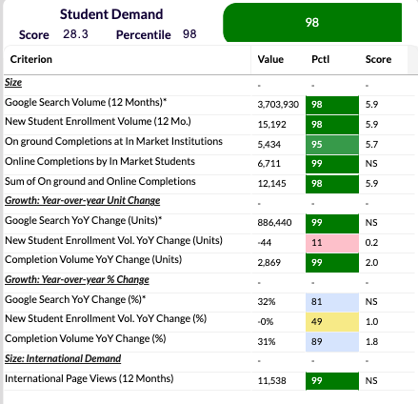
Student Demand
Cybersecurity scores in the 98th percentile for Student Demand.
Size metrics are very strong.
  Google searches are in the 98th percentile.
  New enrollment is in the 98th.
  Online completions are in the 99th.
  Overall completions are in the 98th.
Year over year is healthy.
  Google rose 32% year over year.
  New student enrollment was flat.
  Completions rose 31%.
International demand is very high.
Source: Gray DI’s PES Markets

Slide 31
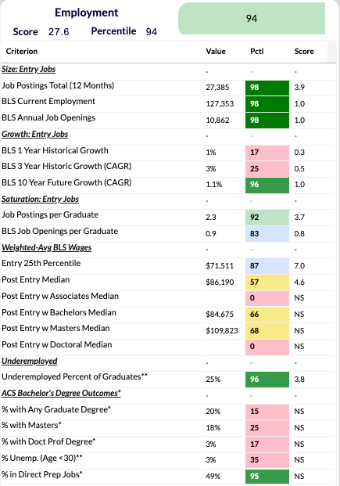
Employment Opportunities
This program scores in the 94th percentile for Employment.
Entry-level job postings and BLS current employment are healthy: 98th percentile.
BLS year-over-year growth is low.
  Entry-level jobs rose 1% year over year.
  They rose an average of 3% over the last three years.
2.3 job postings per graduate ranks at the 92nd percentile.
Wages at the bachelor’s level are fair.
  Entry-level wages are in the 87th percentile.
  Post-entry median with a bachelor’s is in the 66th percentile.
25% of graduates are underemployed (96th percentile).
Source: Gray DI’s PES Markets

Slide 32
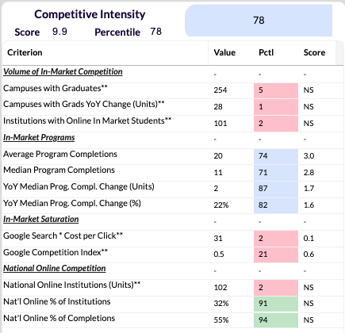
Competition for Students
This program scores in the 78th percentile for competitive intensity.
254 colleges offer this program.
  In 2024, 28 additional campuses had completions.
  Only 5% of programs are offered by more institutions.
Median program size is average (71st percentile). It grew a bit year over year.
Marketing costs are high.
32% of institutions offer this program online.
55% of completions are online.
Source: Gray DI’s PES Markets

Slide 33
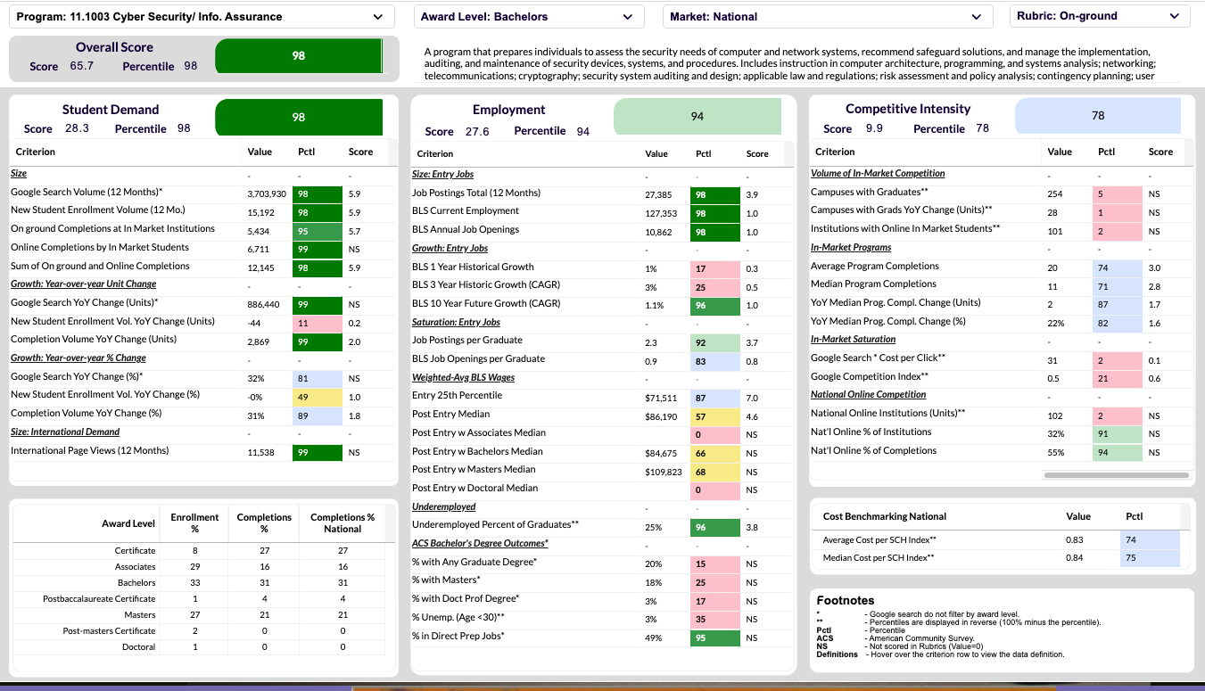

Slide 34
Agenda
What Is a Program Evaluation System?
Student Demand Indicators
Employment: Current Indicators
Program of the Month
Summary

Slide 35
Summary
In July 2026, Google searches for academic programs fell 36% year over year, slightly more than in prior months.
  Drafting and Design Tech grew the most in searches at the associate and certificate levels.
  Computer Programming grew the most at the bachelor’s and above levels.
In Spring 2026, new enrollment was flat to down across award levels.
  Associate and Below: Building Construction/Site Mgmt had the highest year-over-year growth.
  Bachelor’s: Supply Chain grew the most.
  Graduate: Artificial Intelligence had the highest growth.
In July 2026, US job postings fell 3% year-over-year.
  Industrial Engineers was the fastest-growing occupation.
  Skills in business, software, manufacturing, and compliance are in growing demand.
Student demand and employment for a Bachelor’s in Cybersecurity are strong.
  However, this program is competitive.

Slide 36
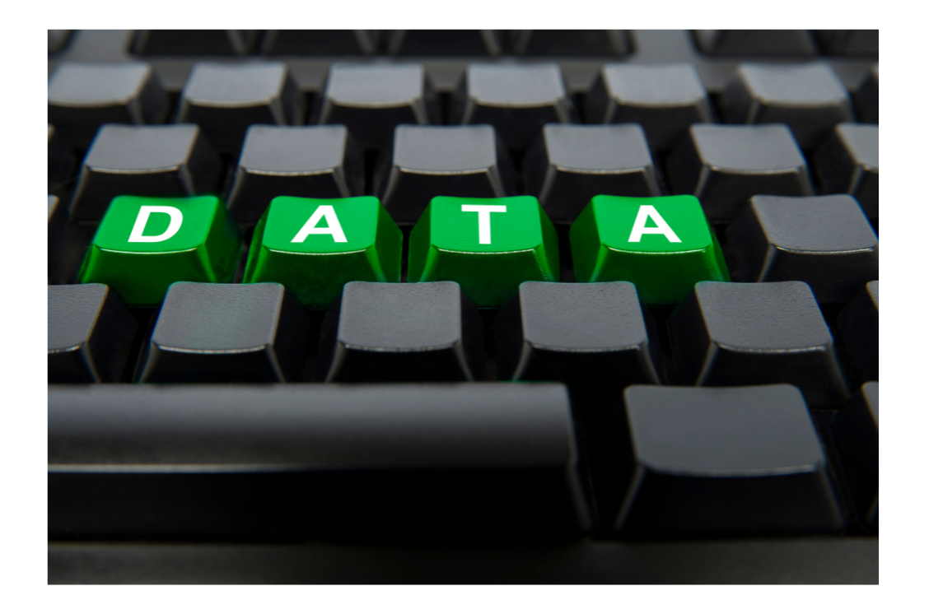
Next Month’s Webinar
September 24th
2 PM ET
September Demand Trends

